Slide 1
Lecture 8: Control Statements – Part V
Class page: https://github.com/tsung-wei-huang/cs1410-40
Dr. Tsung-Wei Huang
Department of Electrical and Computer Engineering
University of Utah, Salt Lake City, UT
Notes:
Morning everyone
Today we are looking into control flow in C++.

Slide 2
Announcement
LAB will go virtual starting this Friday
Potential exposure by Department of Public Health
Will resume to physical lab when situations got resolved
Please log into the TA’s zoom links
GitHub: https://github.com/tsung-wei-huang/cs1410-40
First three sections: Dian-Lun Lin
https://utah.zoom.us/j/94816252792
Second two sections: Yasin Zamani
https://utah.zoom.us/j/99070521933
TA released office hours at zoom
Dian-Lun: 12-1 PM every Thursday
Yasin: 2-3 PM every Monday

Slide 3
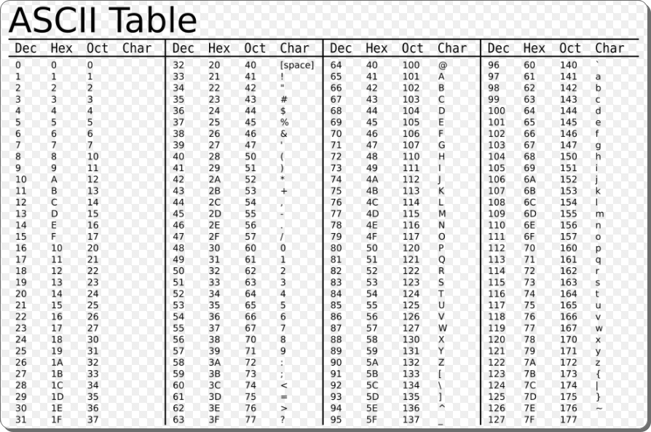
ASCII Code

Slide 4
ASCII Table
You cannot type the value –1 as the sentinel value. (ASCII code is 0~255)
EOF stands for “end-of-file”. Commonly used as a sentinel value for characters.
EOF is a symbolic integer constant defined in the <iostream> header file.
The EOF has type int
The keystroke combinations for entering end-of-file are system dependent.
Windows: Ctrl-Z ; UNIX: Ctrl-D

Slide 5
ASCII Code
To have the program read the characters, we must send them to the computer by pressing the Enter key.
This places a newline character in the input after the character we wish to process.
Often, this newline character must be specially processed.
The cin.get() function can ignore the newline character automatically
Some functions can do this, but some functions cannot.

Slide 6
break and continue statements
The break statement, when executed in a while, for, do…while or switch statement, causes immediate exit from that statement.
Program execution continues with the next statement.
Common uses of the break statement are to escape early from a loop or to skip the remainder of a switch statement.

Slide 7
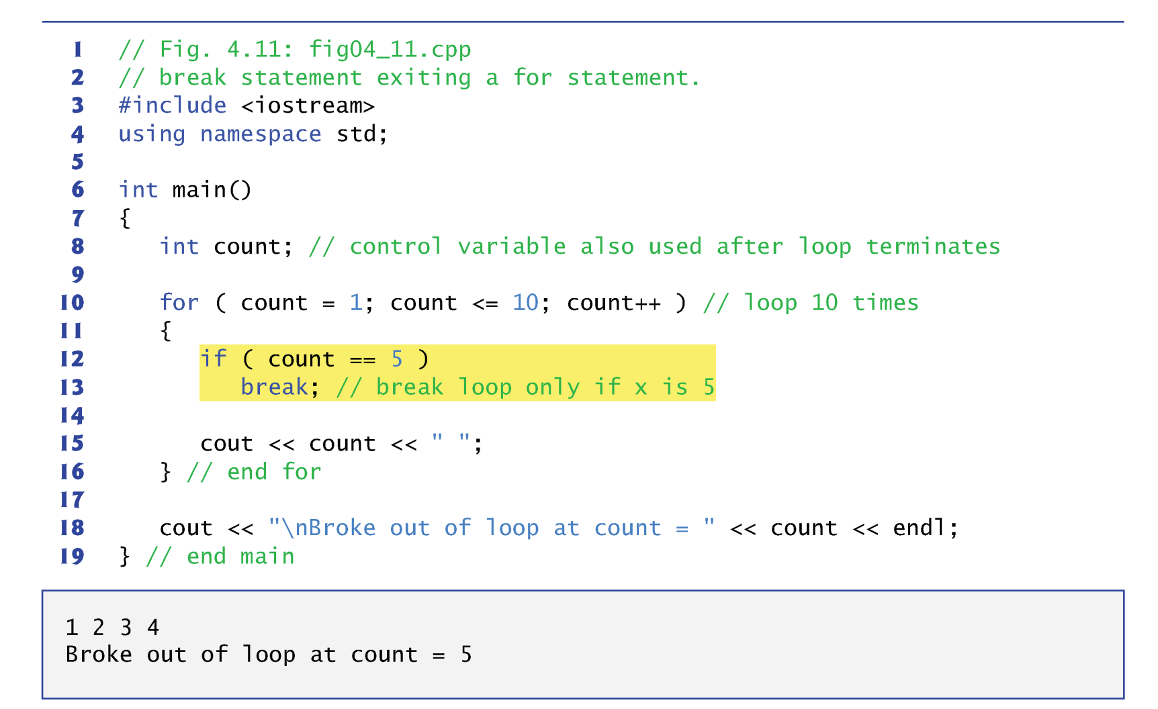
break and continue statements

Slide 8
break and continue statements
The continue statement skips the remaining statements in its body and proceeds with the next iteration of the loop.
When executed in a while, for or do…while statement
In while and do…while statements, the loop-continuation test evaluates immediately after the continue statement executes.
In the for statement, the increment expression executes, then the loop-continuation test evaluates.

Slide 9
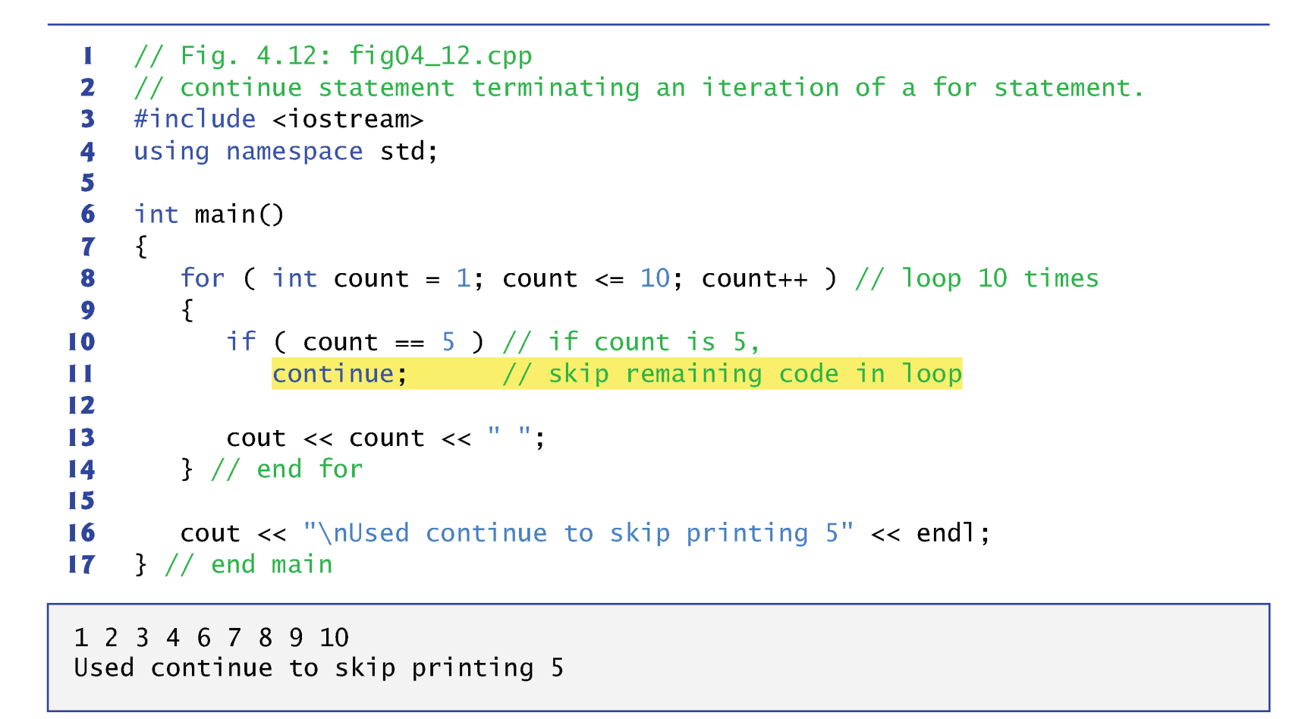
break and continue statements

Slide 10
Usage in Infinite Loop
Infinite loops are helpful when the termination condition is generated inside the loop
while (1) {
......
ans = a * b;
if (ans == 0) break;
......
}
Should be used with break to terminate the loop
Make sure the condition will eventually become TRUE
If sentinel-controlled loop can be used instead, use it !!
Infinite loops are not easy to debug
1 (non-zero value)
means always TRUE

Slide 11
Practice 1
Write a program that prints all multiples of 3
Version 1: for loop + continue
Version 2: while loop + break
Input: N
Output: multiples of 3 in the range [1, n]
Example
N=10 => output: 3, 6, 9
N=17 => output: 3, 6, 9, 12, 15

Slide 12
Practice 2: 3n+1
Consider the following two operations on an arbitrary positive integer:
If the number is even, divide it by two.
If the number is odd, triple it and add one.
The Collatz conjecture is: This process will eventually reach the number 1, regardless of which positive integer is chosen initially.
Write a program that takes an input N and then prints your progress of 3n+1. For example, when N=12, your program prints 12, 6, 3, 10, 5, 16, 8, 4, 2, 1.

Slide 13
Break & Continue Scope of Effect
In nested loops, break/continue can only affect the most inner loop where the break/continue stands
for (i=1; i<=5; i++)
{ for (j=1; j<=3; j++)
{
printf(“(%d,%d) “,i,j);
if (i==3) break;
}
printf(“\n”);
}
If break is used to skip
the following switch
statements, it has no
effects on the outside loop
One-time use only
break inner
loop j only
(1,1) (1,2) (1,3)
(2,1) (2,2) (2,3)
(3,1)
(4,1) (4,2) (4,3)
(5,1) (5,2) (5,3)
Jump out the inner loop
and start from here

Slide 14
Logical Operators
C++ provides logical operators that are used to form more complex conditions by combining simple conditions.
&& (logical AND)
|| (logical OR)
! (logical NOT, also called logical negation).

Slide 15
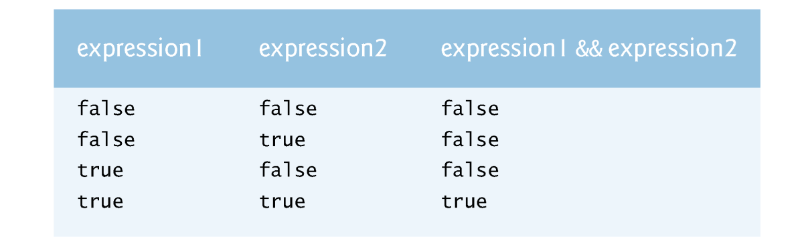

Logical Operators
AND Operator &&
OR Operator ||

Slide 16
Practice 3
Input: N
Output
If N is larger than 10 and N is an even number
Print ”N is an even number larger than 10”
If N is larger than 10 and N is an odd number
Print “N is an odd number larger than 10”
If N is smaller than or equal to 10, and is even
Print “N is an even number <= 10”
If N is smaller than or equal to 10, and is odd
Print “N is an odd number <= 10”

Slide 17
Summary
while loop statement
do...while loop statement
for loop statement
switch statement
continue and break
logical operators &&, ||, !

